Slide 1

CSE 473: Pattern Recognition

Slide 2
Unsupervised Learning:
Clustering

Slide 3

Bisecting k-means
Bisecting k-means algorithm
  Variant of k-means that can produce a partitional or a hierarchical clustering

Slide 4
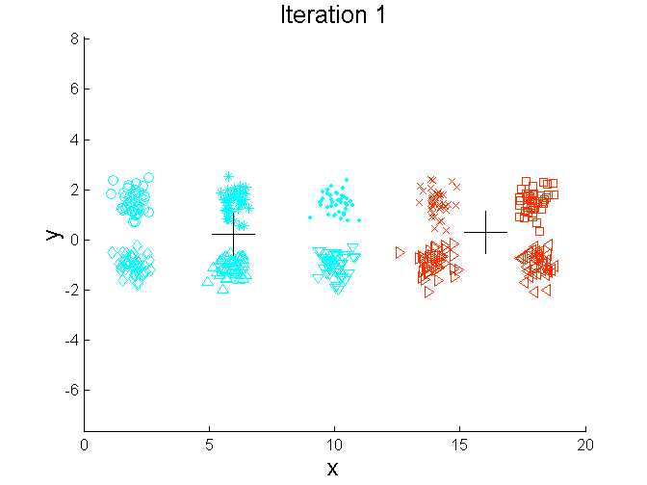
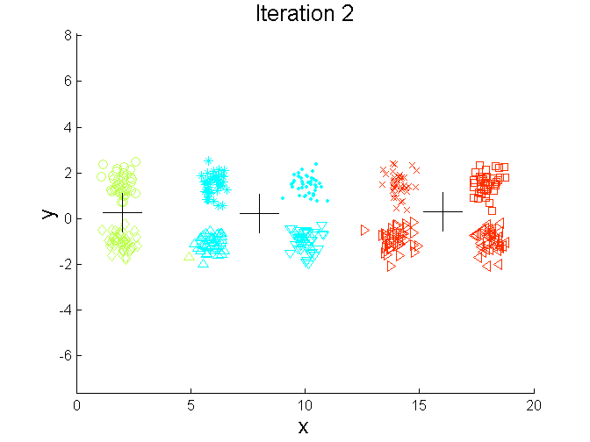
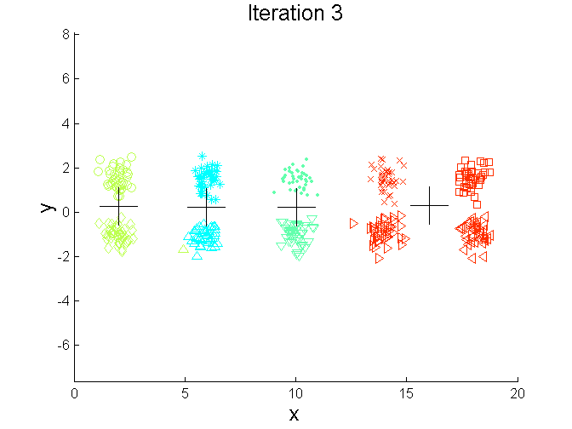
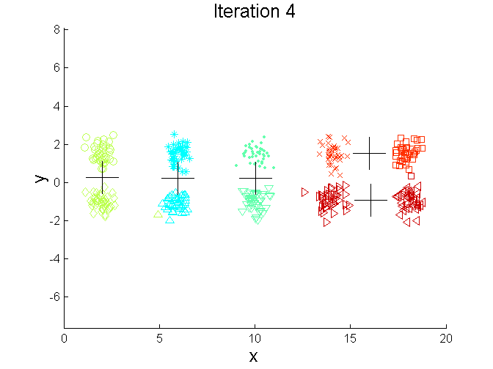
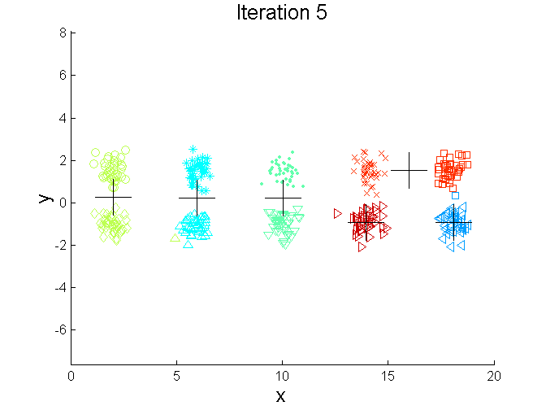
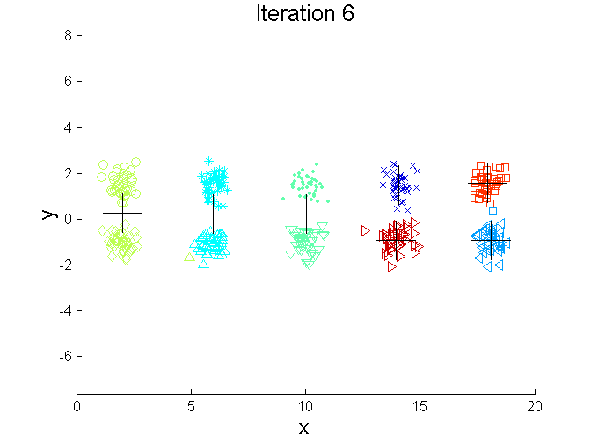
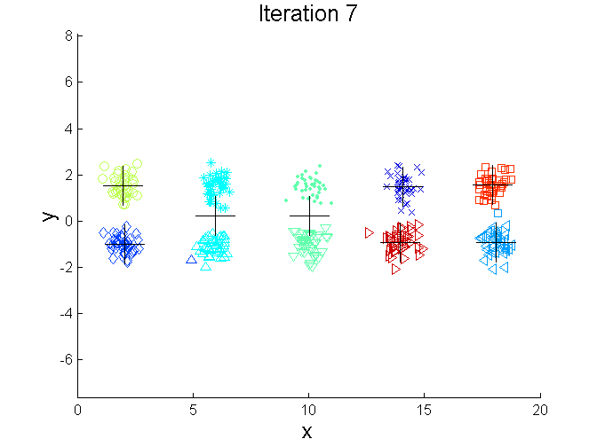
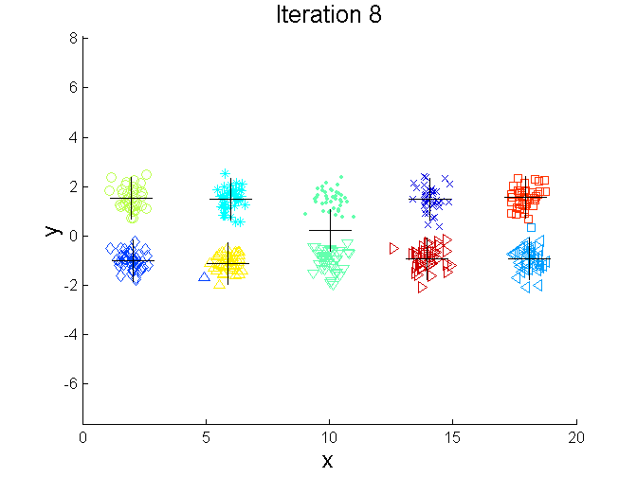
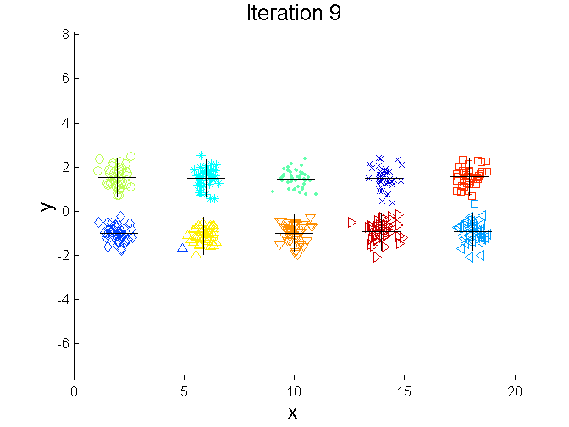
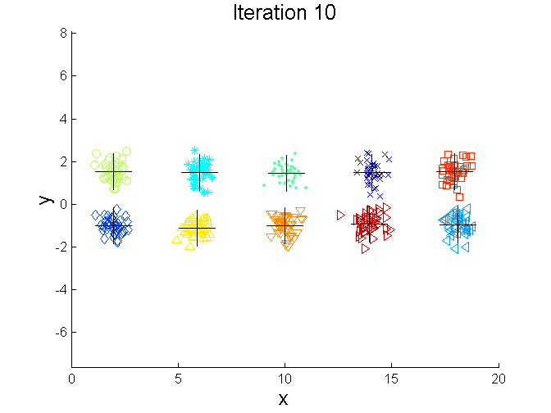
Bisecting k-means Example

Slide 5
Bisecting k-means as an initialization for a global k-means run
bisecting k-means
  bisects individual clusters
  finds local minima of SSE
  usually does not provide optimal clustering

Slide 6
Bisecting k-means as an initialization for a global k-means run
bisecting k-means
  bisects individual clusters
  finds local minima of SSE
  usually does not provide optimal clustering
final centroids from bisecting k-means can be used as initial centroids of a global k-means run

Slide 7
Limitations of k-means
k-means has problems when clusters are of differing
  Sizes
  Densities
  Non-globular shapes
k-means has problems when the data contains outliers.

Slide 8


Limitations of k-means: Differing Sizes
Original Points
k-means (3 Clusters)

Slide 9


Limitations of k-means: Differing Density
Original Points
k-means (3 Clusters)

Slide 10


Limitations of k-means: Non-globular Shapes
Original Points
k-means (2 Clusters)

Slide 11

Overcoming k-means Limitations
Original Points k-means Clusters
One solution is to use many clusters.
  Find parts of clusters, but need to put together.

Slide 12
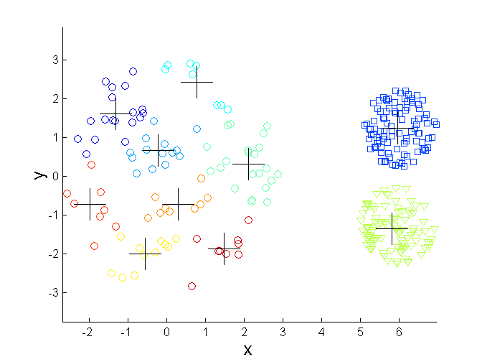
Overcoming k-means Limitations
Original Points k-means Clusters

Slide 13
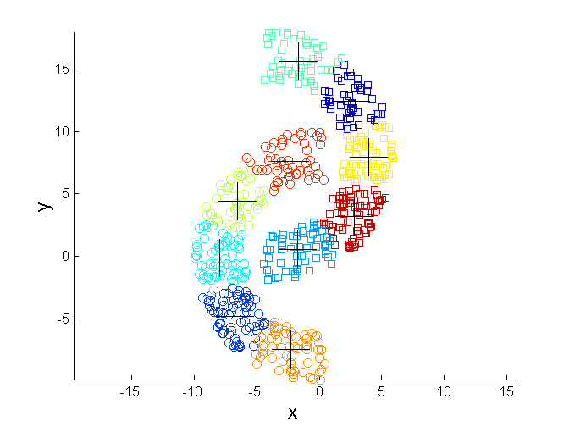
Overcoming k-means Limitations
Original Points k-means Clusters

Slide 14


Hierarchical Clustering
Produces a set of nested clusters organized as a hierarchical tree
Can be visualized as a dendrogram
  A tree like diagram that records the sequences of merges or splits

Slide 15
Strengths of Hierarchical Clustering
Do not have to assume any particular number of clusters
  Any desired number of clusters can be obtained by ‘cutting’ the dendogram at the proper level

Slide 16
Strengths of Hierarchical Clustering
They may correspond to meaningful taxonomies
  Example in biological sciences (e.g., animal kingdom, phylogeny reconstruction, …)
all living beings
animals
plants

Slide 17
Hierarchical Clustering
Two main types of hierarchical clustering
  Agglomerative:
    Start with the points as individual clusters
    At each step, merge the closest pair of clusters until only one cluster (or k clusters) left
  Divisive:
    Start with one, all-inclusive cluster
    At each step, split a cluster until each cluster contains a point (or there are k clusters)
Traditional hierarchical algorithms use a similarity or distance matrix
  Merge two clusters or split one cluster at a time

Slide 18
Agglomerative Clustering Algorithm
More popular hierarchical clustering technique
Basic algorithm is straightforward
  Compute the proximity matrix
  Let each data point be a cluster
  Repeat
  Merge the two closest clusters
  Update the proximity matrix
  Until only a single cluster remains
Key operation is the computation of the proximity bet^{n} two clusters
  Different approaches to defining the distance between clusters distinguish the different algorithms

Slide 19
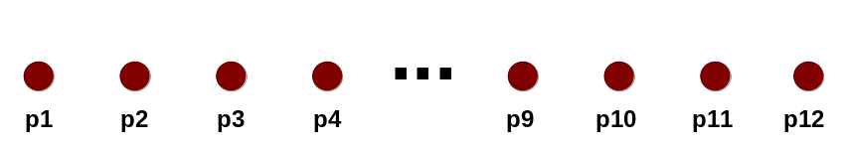
Starting Situation
Start with clusters of individual points and a proximity matrix
p1
p2
p3
p4
p5
. . .
p1
p2
p3
p4
p5
.
.
.
Proximity Matrix

Slide 20
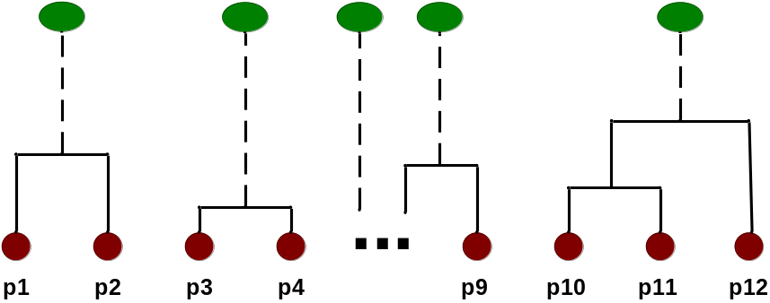
Intermediate Situation
After some merging steps, we have some clusters
C1
C2
C3
C4
C5
C1
C2
C3
C3
C4
C4
C5
Proximity Matrix
C1
C2
C5

Slide 21

Intermediate Situation
We want to merge the two closest clusters (C2 and C5) and update the proximity matrix.
C1
C2
C3
C4
C5
C1
C2
C3
C3
C4
C4
C5
Proximity Matrix
C1
C2
C5

Slide 22

After Merging
The question is “How do we update the proximity matrix?”
C2 U C5
C1
C3
C4
C1
?
C2 U C5
? ? ? ?
C3
C3
?
C4
C4
?
Proximity Matrix
C1
C2 U C5

Slide 23
How to Define Inter-Cluster Similarity
p1
p2
p3
p4
p5
. . .
p1
Similarity?
p2
p3
p4
p5
MIN
MAX
Group Average
Distance Between Centroids
Other methods driven by an objective function
  Ward’s Method uses squared error
.
.
.
Proximity Matrix

Slide 24
How to Define Inter-Cluster Similarity
p1
p2
p3
p4
p5
. . .
p1
p2
p3
p4
p5
MIN
MAX
Group Average
Distance Between Centroids
Other methods driven by an objective function
  Ward’s Method uses squared error
.
.
.
Proximity Matrix

Slide 25
How to Define Inter-Cluster Similarity
p1
p2
p3
p4
p5
. . .
p1
p2
p3
p4
p5
MIN
MAX
Group Average
Distance Between Centroids
Other methods driven by an objective function
  Ward’s Method uses squared error
.
.
.
Proximity Matrix

Slide 26
How to Define Inter-Cluster Similarity
p1
p2
p3
p4
p5
. . .
p1
p2
p3
p4
p5
MIN
MAX
Group Average
Distance Between Centroids
Other methods driven by an objective function
  Ward’s Method uses squared error
.
.
.
Proximity Matrix

Slide 27
How to Define Inter-Cluster Similarity
p1
p2
p3
p4
p5
. . .
p1
×
×
p2
p3
p4
p5
MIN
MAX
Group Average
Distance Between Centroids
Other methods driven by an objective function
  Ward’s Method uses squared error
.
.
.
Proximity Matrix

Slide 28
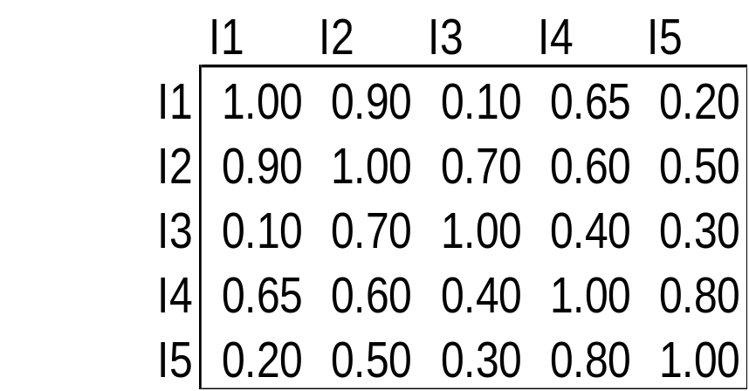
Cluster Similarity: MIN or Single Link
Similarity of two clusters is based on the two most similar (closest) points in the different clusters
1
2
3
4
5

Slide 29

Hierarchical Clustering: MIN
5
1
3
5
2
1
2
3
6
4
4
Nested Clusters
Dendrogram

Slide 30

Cluster Similarity: MAX or Complete Linkage
Similarity of two clusters is based on the two least similar (most distant) points in the different clusters
1
2
3
4
5

Slide 31
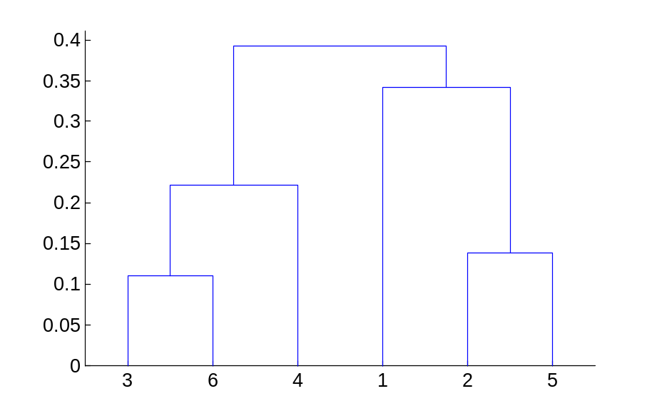
Hierarchical Clustering: MAX
4
1
2
5
5
2
3
6
3
1
4
Nested Clusters
Dendrogram

Slide 32
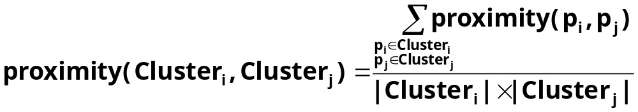

Cluster Similarity: Group Average
Proximity of two clusters is the average of pairwise proximity between points in the two clusters.
1
2
3
4
5

Slide 33

Hierarchical Clustering: Group Average
5
4
1
2
5
2
3
6
1
4
3
Nested Clusters
Dendrogram

Slide 34
Hierarchical Clustering: Group Average
Compromise between Single and Complete Link
Strengths
  Less susceptible to noise and outliers
Limitations
  Biased towards globular clusters

Slide 35
Cluster Similarity: Ward’s Method
Proximity of two clusters is based on the increase in squared error when two clusters are merged
  Similar to group average if distance between points is distance squared
Less susceptible to noise and outliers
Biased towards globular clusters

Slide 36
Hierarchical Clustering: Comparison
5
1
4
1
3
2
5
5
5
2
1
MIN
2
MAX
2
3
6
3
3
6
1
4
4
4
5
5
1
4
1
2
2
5
2
Ward’s Method
5
2
3
6
Group Average
3
3
6
4
1
1
4
4
3

Slide 37
Hierarchical Clustering: Problems and Limitations
Once a decision is made to combine two clusters, it cannot be undone
No objective function is directly minimized
Different schemes have problems with one or more of the following:
  Sensitivity to noise and outliers
  Difficult to handle different sized clusters and convex shapes
  Breaking large clusters

Slide 38
Density based Clustering
locates high density regions in low density regions
requires to define
  What is the density

Slide 39
DBSCAN
DBSCAN is a density-based algorithm.
  Density = number of points within a specified radius (Eps)

Slide 40
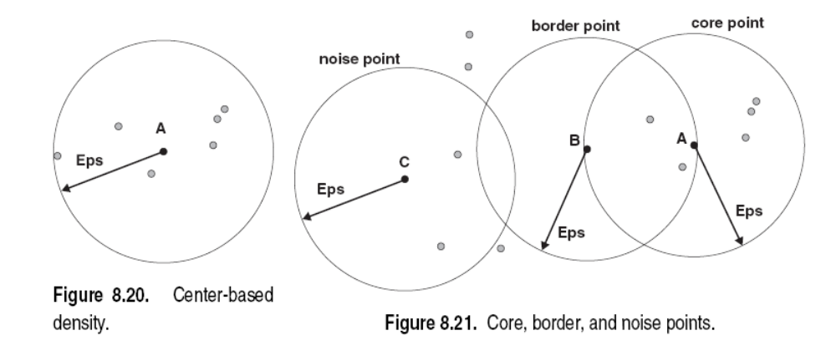
DBSCAN
DBSCAN is a density-based algorithm.
  Density = number of points within a specified radius (Eps)

Slide 41
DBSCAN
DBSCAN is a density-based algorithm.
  Density = number of points within a specified radius (Eps)
  density is calculated based on
  core point
  border point
  noise point

Slide 42

DBSCAN
  A point is a core point if it has more than a specified number of points (MinPts) within Eps
    These are points that are at the interior of a cluster
X
MinPts = 7

Slide 43
DBSCAN
  A border point has fewer than MinPts within Eps, but is in the neighborhood of a core point
X
MinPts = 7

Slide 44
DBSCAN
  A noise point is any point that is not a core point or a border point.
X
X
MinPts = 7

Slide 45
DBSCAN Algorithm
Eliminate noise points
Perform clustering on the remaining points
  Put an edge between all core points which are within Eps
  Make each group of core points as a cluster
  Assign border point to one of the clusters of its associated core points

Slide 46

DBSCAN: Core, Border and Noise Points
Original Points

Slide 47
DBSCAN: Core, Border and Noise Points
Original Points
Eps = 10, MinPts = 4

Slide 48

DBSCAN: Core, Border and Noise Points
Original Points
Point types: core, border and noise
Eps = 10, MinPts = 4

Slide 49

When DBSCAN Works Well
Original Points
Clusters

Slide 50
When DBSCAN Works Well
Original Points
Clusters
Resistant to Noise
Can handle clusters of different shapes and sizes

Slide 51
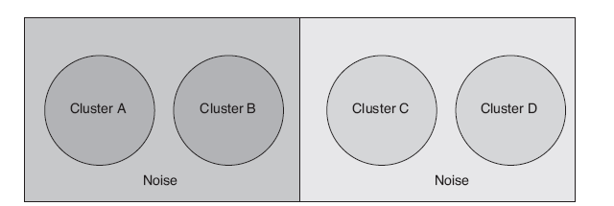
When DBSCAN Does NOT Work Well

Slide 52
When DBSCAN Does NOT Work Well
when Eps is low enough
  successfully finds low density clusters C and D
  considers the left side as a single cluster

Slide 53
When DBSCAN Does NOT Work Well
when Eps is high enough
  successfully finds high density clusters A, B
  considers others as noise

Slide 54
DBSCAN: Determining EPS and MinPts

Slide 55
DBSCAN: Determining EPS and MinPts
Note the k-dist of these cluster points
K-dist: distance from kth nearest neighbour

Slide 56
DBSCAN: Determining EPS and MinPts
Note the k-dist of these cluster points
K-dist should be very similar

Slide 57
DBSCAN: Determining EPS and MinPts
K-dist should be very similar
Unless densities change significantly

Slide 58
DBSCAN: Determining EPS and MinPts
K-dist should be very similar

Slide 59
DBSCAN: Determining EPS and MinPts
K-dist should be very similar
However, k-dist for noise/outlier will be different

Slide 60
DBSCAN: Determining EPS and MinPts
For points in a cluster, their k^{th} nearest neighbors are at roughly the same distance
Noise points have the k^{th} nearest neighbor at farther distance
So, plot sorted distance of every point to its k^{th} nearest neighbor

Slide 61
DBSCAN: Determining EPS and MinPts
Idea is that for points in a cluster, their k^{th} nearest neighbors are at roughly the same distance
Noise points have the k^{th} nearest neighbor at farther distance
So, plot sorted distance of every point to its k^{th} nearest neighbor

Slide 62
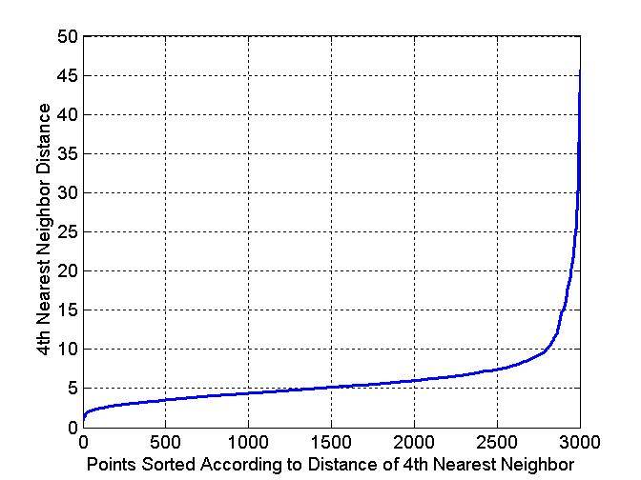
DBSCAN: Determining EPS and MinPts
Idea is that for points in a cluster, their k^{th} nearest neighbors are at roughly the same distance
Noise points have the k^{th} nearest neighbor at farther distance
So, plot sorted distance of every point to its k^{th} nearest neighbor

Slide 63
DBSCAN: Problems and Limitations
Resistant to noise
Handle different sizes of clusters
Problems with the following:
  Different densities
  Density/proximity analysis for high dimension

